Slide 1

Logistic Model
Moussa Doumbia, Ph.D.
Howard University
Thursday, September 29, 2022

Slide 2
Background
Classification model
Logistic Model
Interpret the result
Notes:
Welcome to introduction to Logistic Model lecture. In this lecture, we discuss classification problems, how to logistic regression to solve them to how and to interpret the results of the logistic regression through the confusion matrix.

Slide 3
Background
Spam versus “Ham” emails
Loan Default (Yes/No)
Disease Diagnosis
Notes:
We want to learn about Logistic Regression as a method for classification. In machine learning as statistics, classification is a problem of identifying to which of a set of categories a new observation belongs to based off training data
Some examples of classification problems include trying to detect spam versus ham emails,
Tying to detect whether someone is going to default on their loan or not, even trying to diagnose a disease for example. These above examples are all examples of a binary classification, meaning we have two classes.
Logistic regression allows us to solve classification problems, where we are trying to predict discreate categories.
The convention for binary classification is to have two classes zero and one.

Slide 4
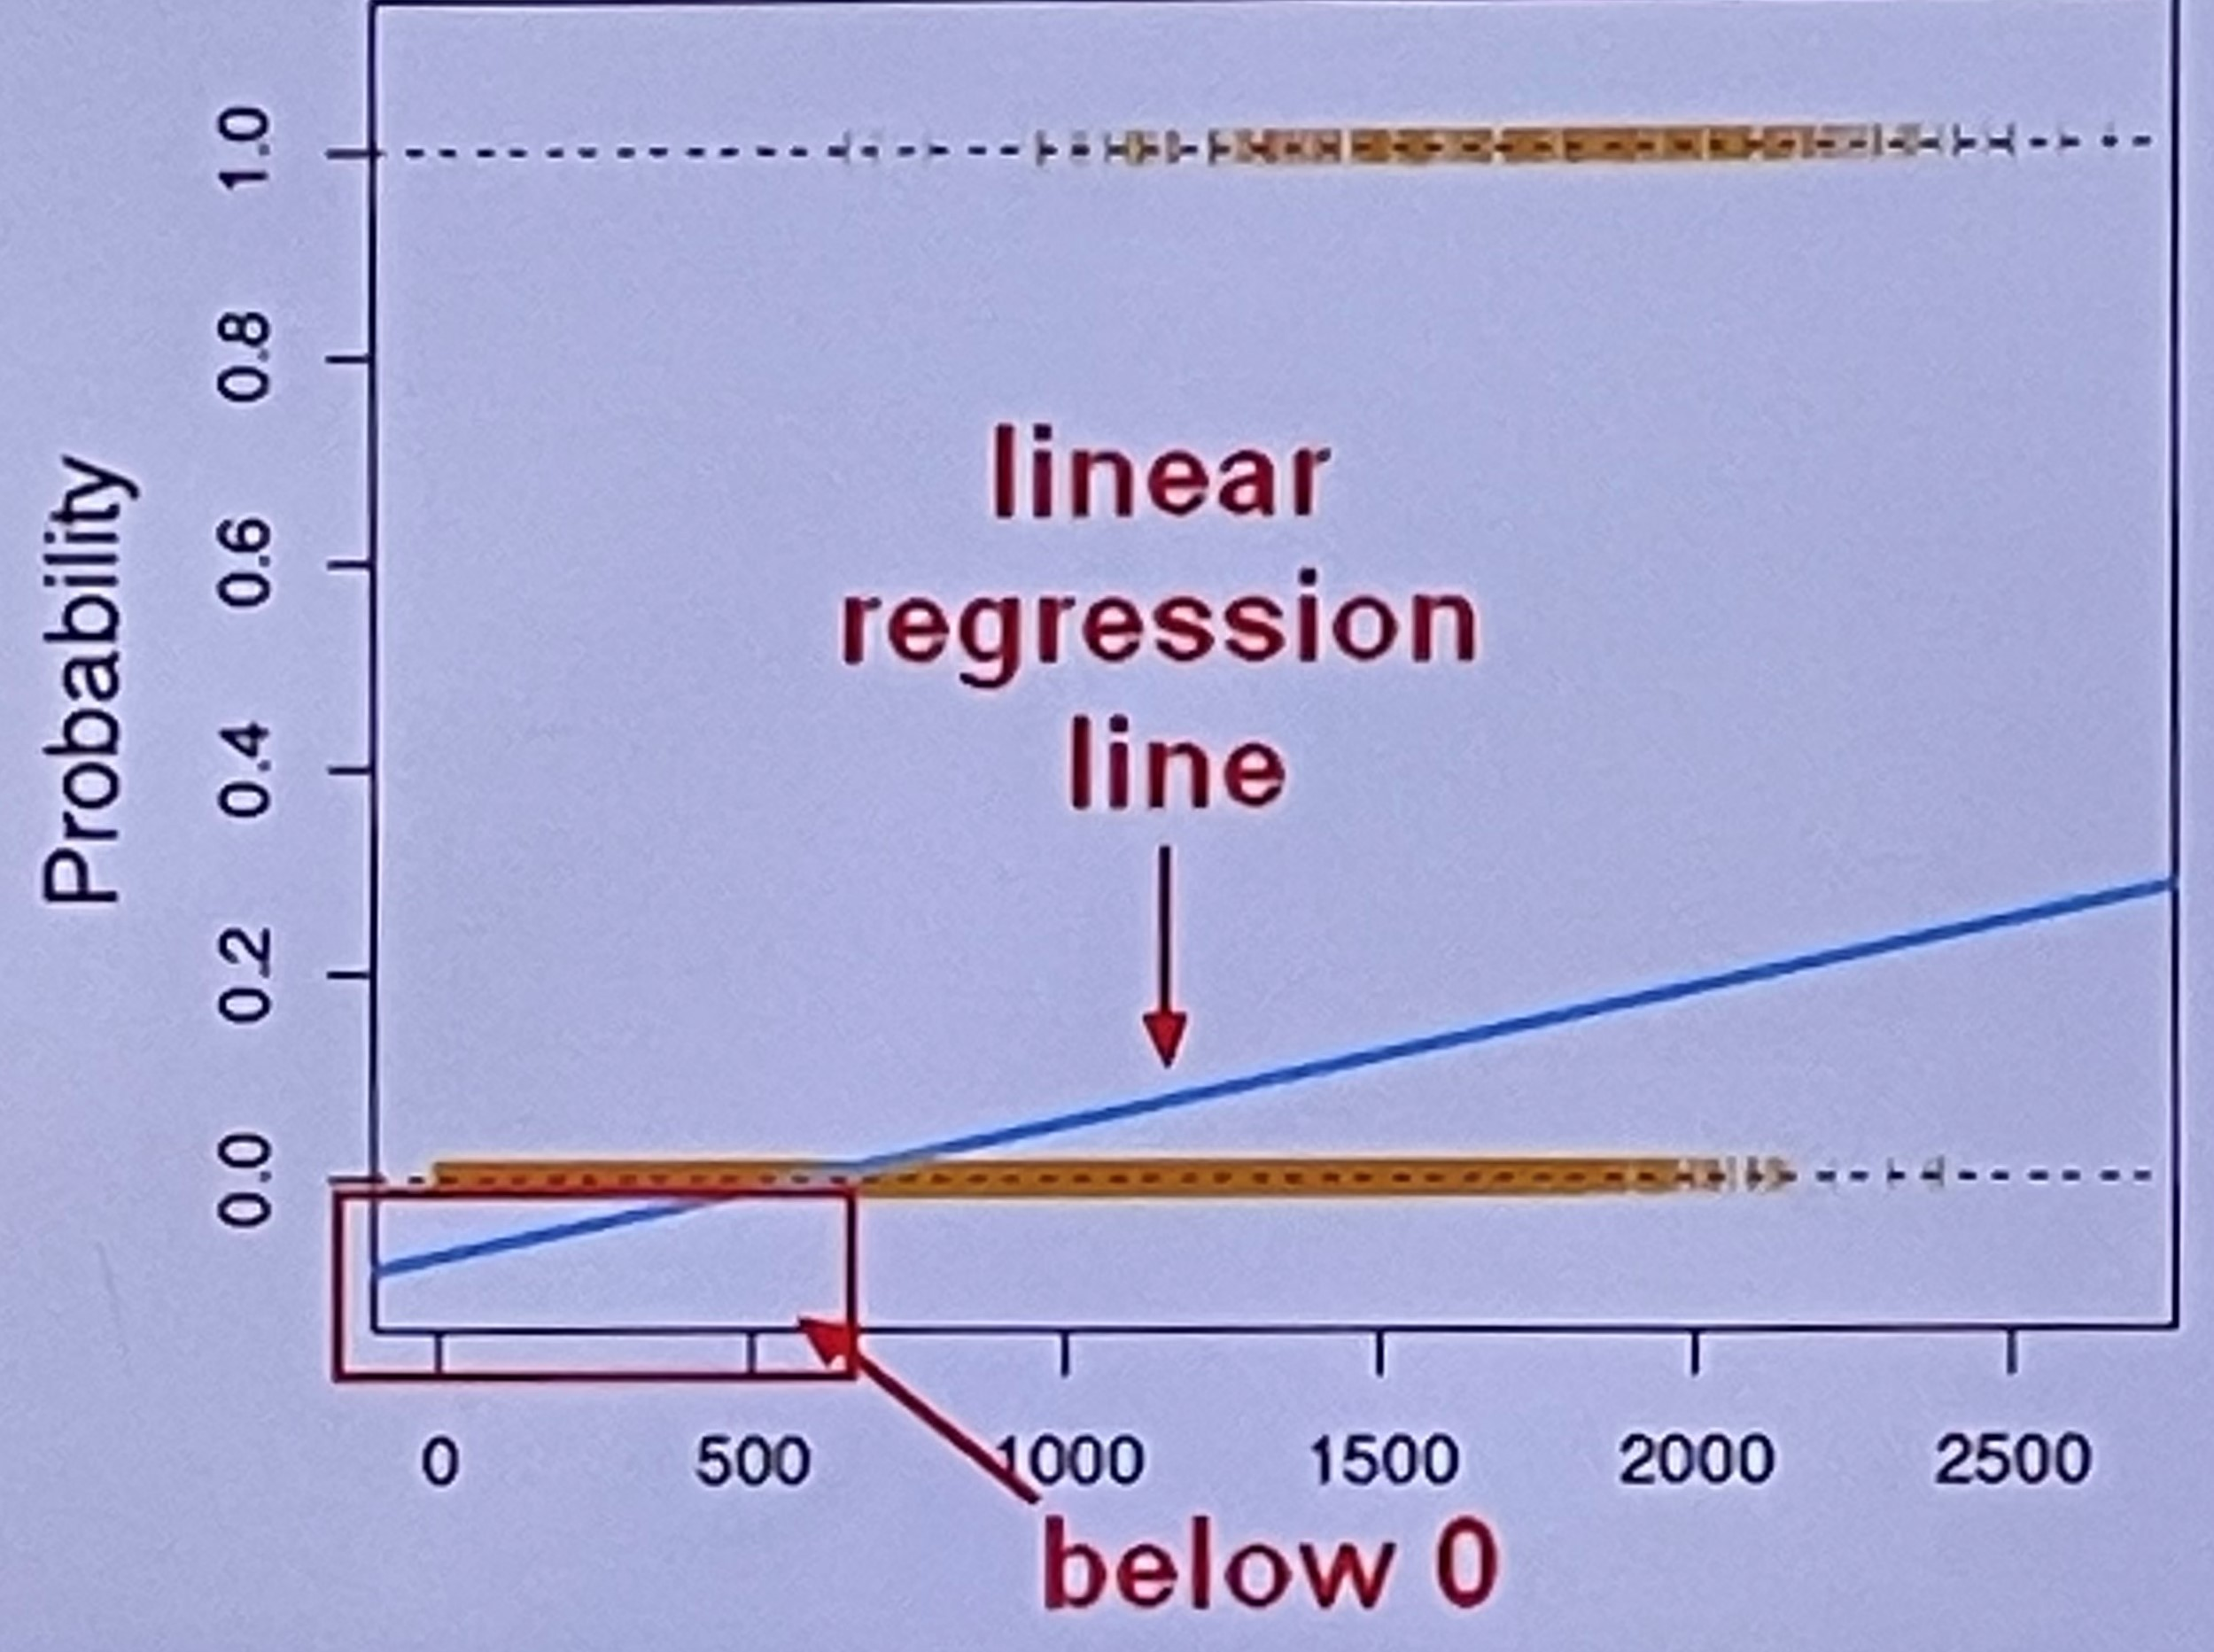
Notes:
However, we can’t use our normal linear regression model on binary groups. It won’t lead to a good fit. For example, if we look at this plot. We have Y axis which the probability of belonging to a group.
Let’s go head and imagine that this example plot is trying to predict likelihood of paying back a loan.
We will go head and label o percent probability as defaulting on their loan, meaning they have 0% probability of being able to pay back their loan. And at the top, we have 1 as 100% probability of being able to pay back their loan.
Instead, we can transform our linear regression to a logistic regression curve. Logistic regression curve can only go between zero and one and that is going to be the key to understand classification using a logistic regression curve the sigmoid, also known as logistic function is going to be the key to understanding using logistic regression to perform a classification.

Slide 5
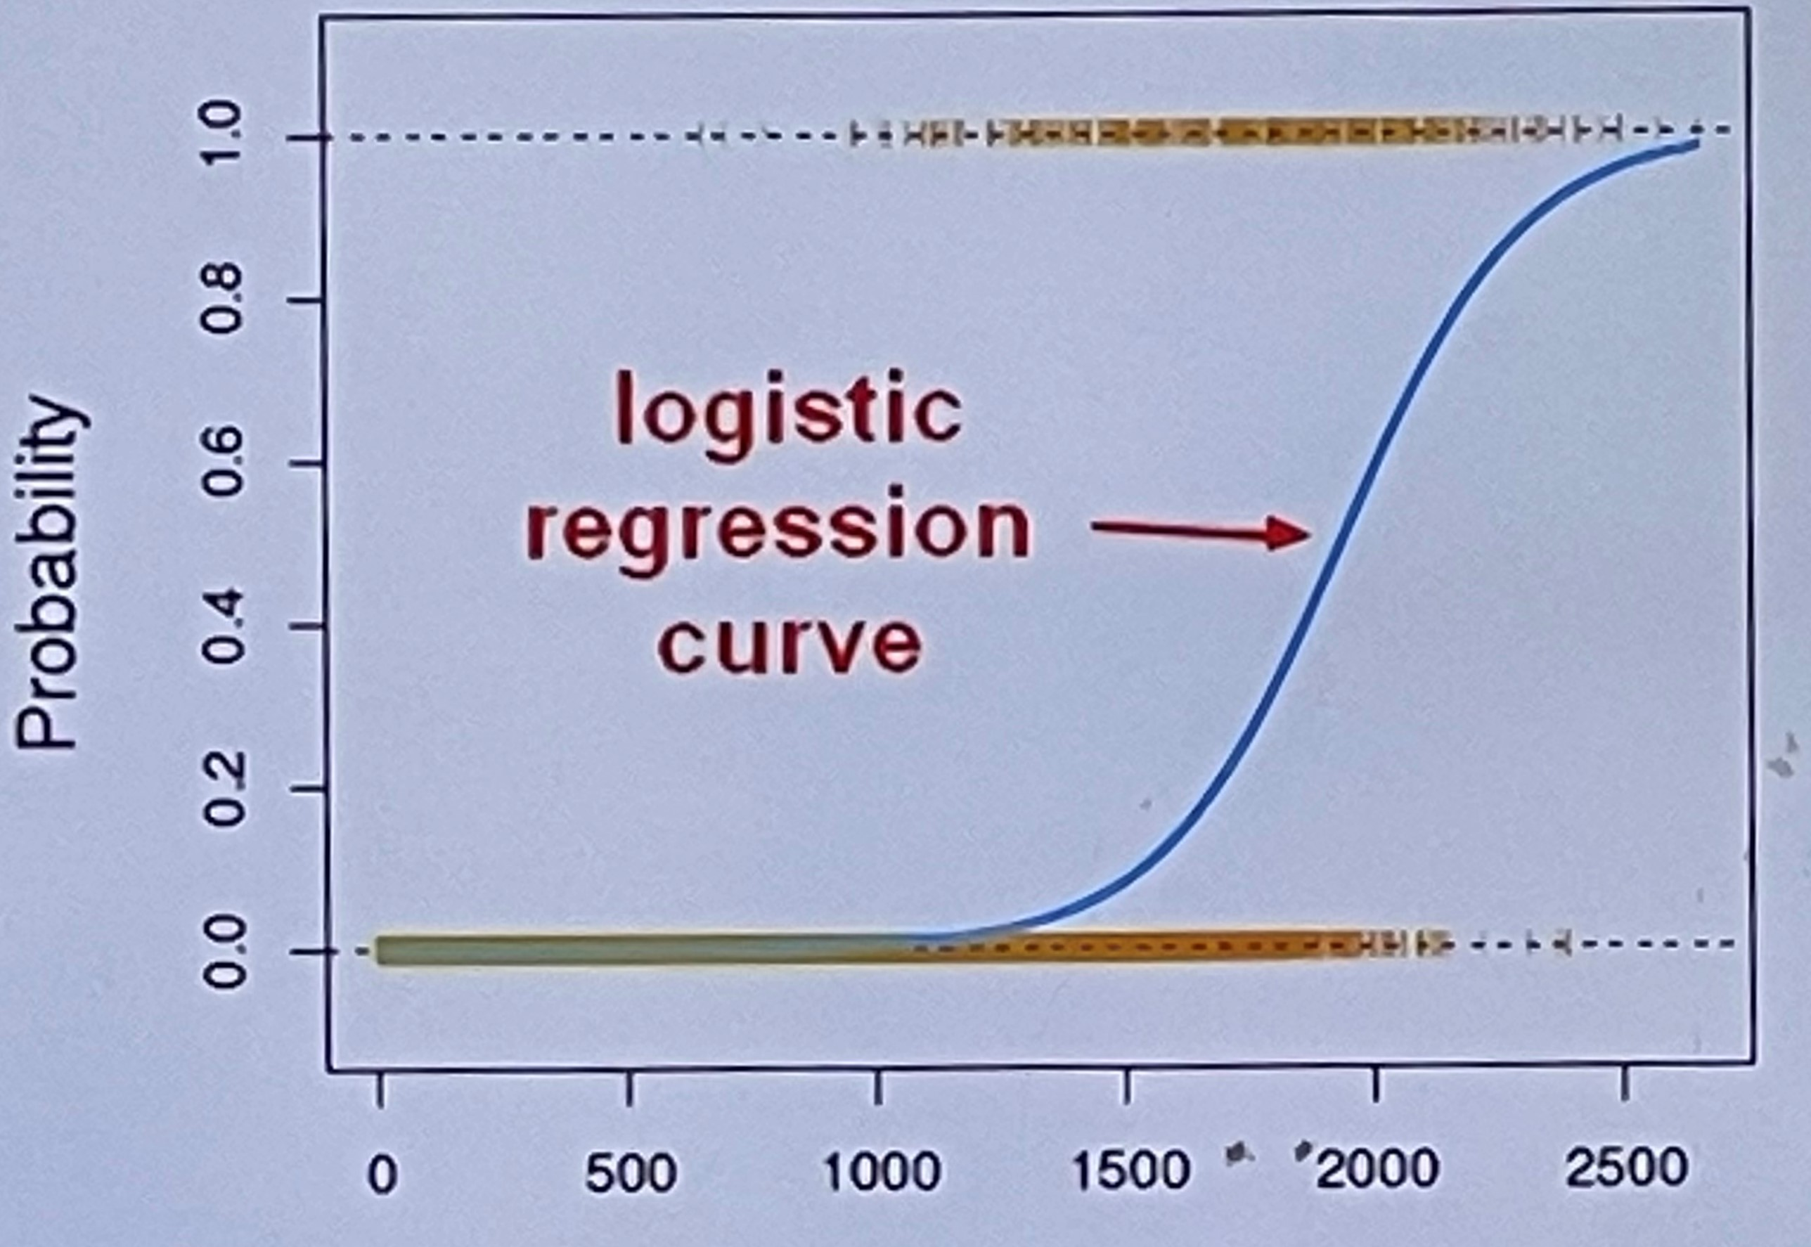
Notes:
Instead, we can transform our linear regression to a logistic regression curve. Logistic regression curve can only go between zero and one and that is going to be the key to understand classification using a logistic regression curve the sigmoid, also known as logistic function is going to be the key to understanding using logistic regression to perform a classification.

Slide 6
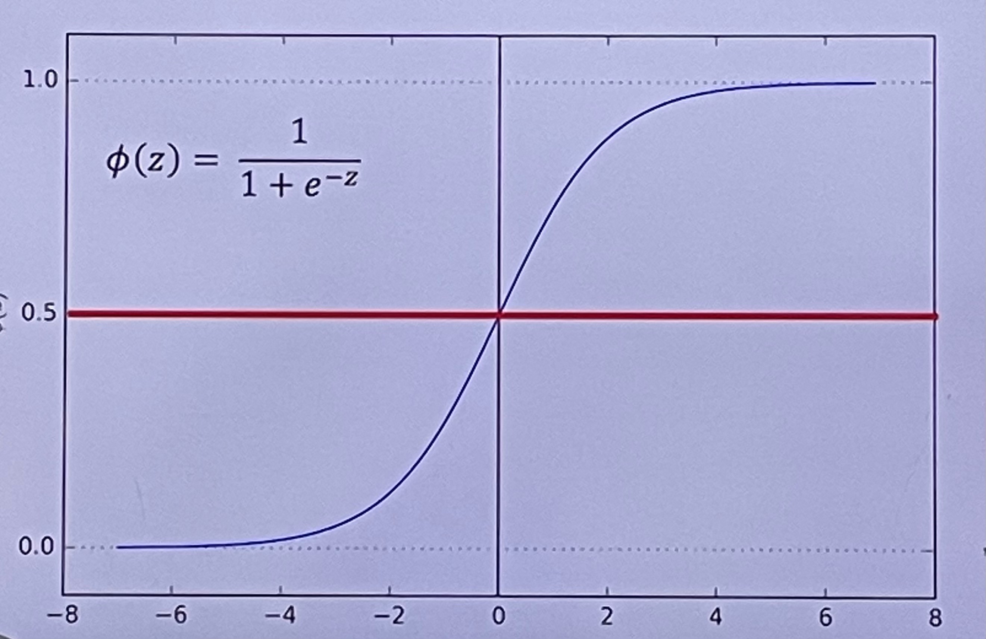
Notes:
Instead, we can transform our linear regression to a logistic regression curve. Logistic regression curve can only go between zero and one and that is going to be the key to understand classification using a logistic regression curve the sigmoid, also known as logistic function is going to be the key to understanding using logistic regression to perform a classification.
The key secret to this function is that it can take in any value and its output is going to be between 0 and 1. We look at the equation here on this plot, we have the sigmoid function plotted out on the z axis is going to be the bottom line. Again, if you look at this function, it does not matter what value to put in for z, the output is going to be between 0 and 1. This means we can our linear reg function and place it into our sigmoid function.
And the output will always be between 0 and 1. That means we can set a cutoff point usually at 0.5 and we’ll say if anything below result in 0.5 or below 0.5 that will go to 0 and anything above 0.5 will go to 1.

Slide 7
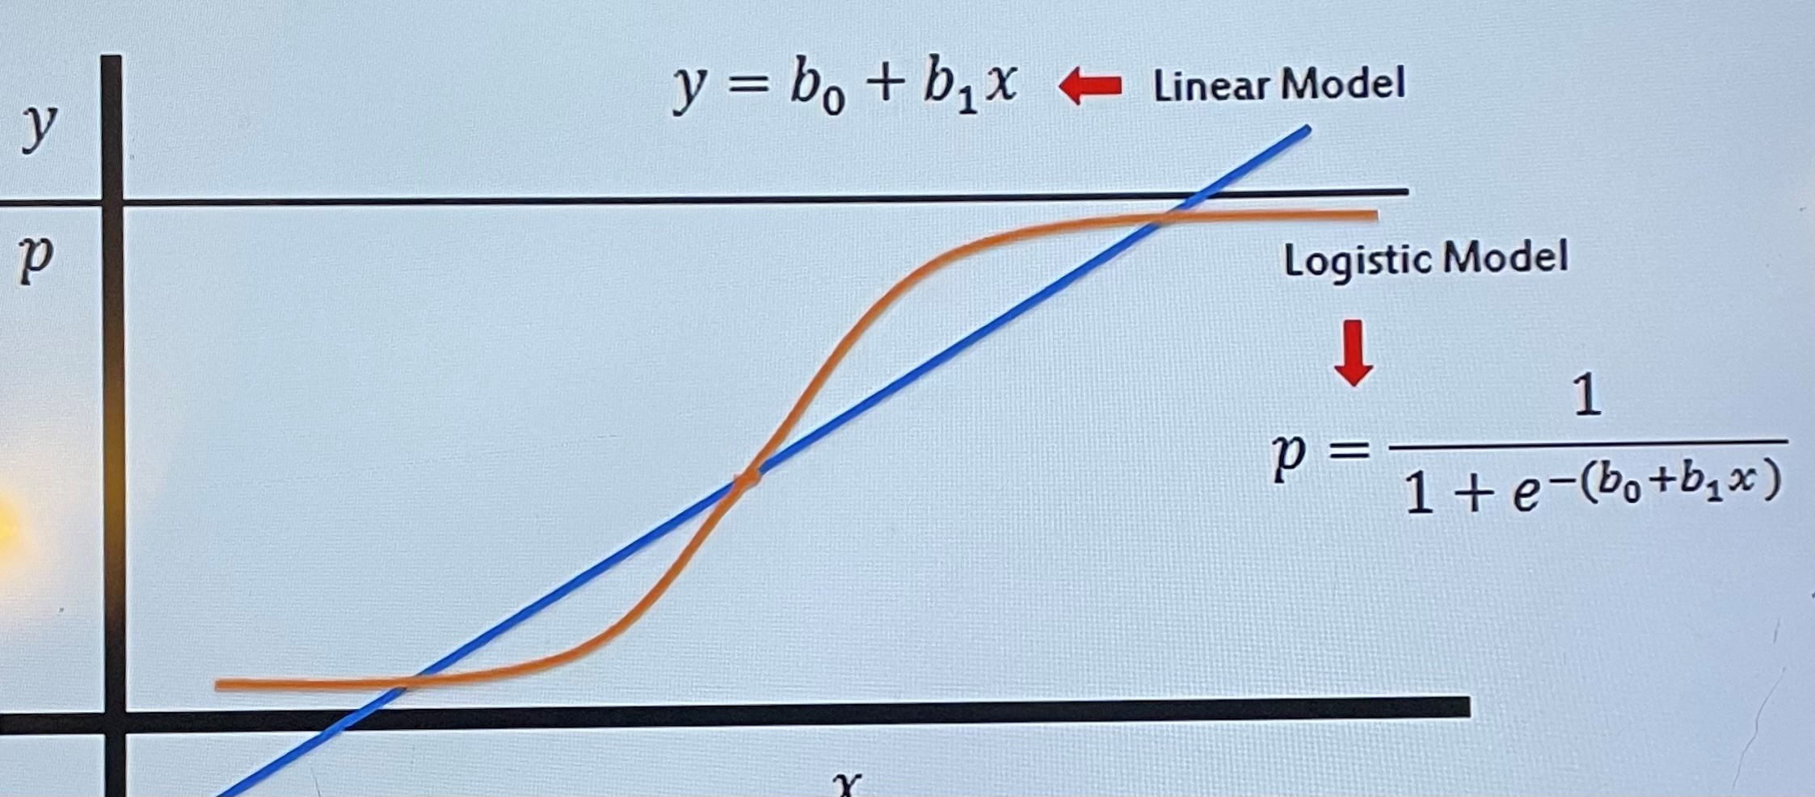
Notes:
Instead, we can transform our linear regression to a logistic regression curve. Logistic regression curve can only go between zero and one and that is going to be the key to understand classification using a logistic regression curve the sigmoid, also known as logistic function is going to be the key to understanding using logistic regression to perform a classification.

Slide 8
Notes:
Instead, we can transform our linear regression to a logistic regression curve. Logistic regression curve can only go between zero and one and that is going to be the key to understand classification using a logistic regression curve the sigmoid, also known as logistic function is going to be the key to understanding using logistic regression to perform a classification.

Slide 9
MODEL EVALUATION
After you train a logistic regression model on some training data, you will evaluate your model’s performance on some test data.
You can use a confusion matrix to evaluate classification models
Notes:
So let’s go head and talk about model evaluation and using a confusion matrix after you train a logistic regression model.
A confusion matrix is a table that is often used to describe the performance of a classification model on a
Set of test data for which the true values are already known

Slide 10
MODEL EVALUATION
N =170 | Predicted: No | Predicted : Yes
Actual: No | 55 | 10
Actual: Yes | 5 | 100
Example: Test for presence of disease
No = negative test = False = 0
Yes = Positive test = True = 1

Slide 11
MODEL EVALUATION
N = 170 | Predicted: No | Predicted: Y
Actual: No | TN= 55 | FP=10 | 65
Actual: Yes | FN=5 | TP=100 | 105
 | 60 | 110
Terminology:
True Positives (TP)
True Negatives (TN)
False Positives (FP)
False Negatives (FN)

Slide 12
MODEL EVALUATION
N = 170 | Predicted: No | Predicted: Y
Actual: No | TN= 55 | FP=10 | 65
Actual: Yes | FN=5 | TP=100 | 105
 | 60 | 110
Accuracy:
Overall, how accurate is it correct?
(TP+TN)/N = 155/170 = 91%
Miscalculating Rate (Error Rate)
Overall, how often is it Wrong?
(FP+FN)/N=15/170 = 9%

Slide 13
MODEL EVALUATION
N = 170 | Predicted: No | Predicted: Y
Actual: No | TN= 55 | FP=10 | 65
Actual: Yes | FN=5 | TP=100 | 105
 | 60 | 110
Terminology:
True Positives (TP)
True Negatives (TN)
False Positives (FP)
False Negatives (FN)
Miscalculating Rate (Error Rate)
Overall, how often is it Wrong?
(FP+FN)/N=15/170= 9%

Slide 14


Thank You
Moussa Doumbia
mdoumbia@howard.edu
www.moussadoumbia.com

